Slide 1
Industrialization
Chapter 5.1 and 5.2

Slide 2

Let’s Go Back for a bit
A Country in Turmoil
Civil War:
  Began: April 12th and April 13th, 1861
  at Fort Sumter
  Ended: April 9, 1865
  at Appomattox Courthouse
  President Lincoln assassinated on
  April 14, 1865

Slide 3
What did the country look like?
30 million people
Only 1.3 million Americans worked in industry
Largely a rural, farm-based country

Slide 4
Big Changes Ahead for the U.S.
After the Civil War, industry rapidly expanded
(Industrialization)
By the late 1800s, the U.S. was the world’s leading industrialized nation
By 1914, the Gross National Product (GNP)- the total value of all goods and services that a country produces- was 8 times greater than it was in 1865 when the Civil War ended!

Slide 5
Natural Resources
The U.S. was rich in resources:
  Timber
  Coal
  Iron
  Copper
  People
    Between 1860 and 1910, the population of the U.S. nearly tripled!

Slide 6


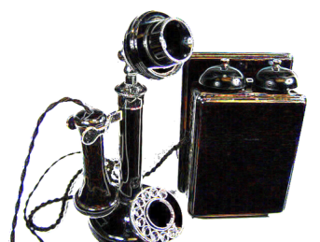

New
Inventions
  Telephone: 1876 Alexander Graham Bell
  Electricity: 1882 Thomas Edison started supplying electric power to New York City
  Car: 1893 Charles and Frank Duryea invent the gasoline-powered automobile
  Airplane: 1903 Wilbur and Orville Wright make first successful powered flight

Slide 7

Transcontinental Railroad
Allowed goods and people to move across the country easily and quickly
  Construction started in 1862
In 1865, the U.S. had 35,000 miles of railroad track
  By 1900, the U.S. had more than 200,000 miles of track
  Lead to the creation of 4 time zones
  Before this, each community set their clock according to the position of the sun

