Slide 1
Industrialization
Chapter 5.1 and 5.2

Slide 2

Let’s Go Back for a bit
A Country in Turmoil
Civil War:
  Began: April 12th and April 13th,
  at Fort Sumter
  Ended: April 9,
  at Appomattox Courthouse
  Assassinated on
  April 14, 1865

Slide 3
What did the country look like?
30 million people
Only million Americans worked in industry
Largely a rural, -based country

Slide 4
Big Changes Ahead for the U.S.
After the Civil War, industry rapidly expanded
( )
By the late 1800s, the U.S. was the world’s leading nation
By 1914, the Gross National Product (GNP)- the of all goods and services that a country produces- was times greater than it was in 1865 when the Civil War ended!

Slide 5
Natural Resources
The U.S. was rich in resources:
  Timber
  Coal
  Iron
  Copper
    Between 1860 and 1910, the population of the U.S. nearly tripled!

Slide 6


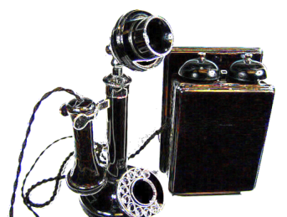

New
Inventions
  : 1876 Alexander Graham Bell
  : 1882 Thomas Edison started supplying electric power to New York City
  : 1893 Charles and Frank Duryea invent the gasoline-powered automobile
  : 1903 Wilbur and Orville Wright make first successful powered flight

Slide 7

Transcontinental Railroad
Allowed goods and people to move across the country easily and quickly
  Construction started in
In 1865, the U.S. had 35,000 miles of railroad track
  By 1900, the U.S. had more than miles of track
  Lead to the creation of 4
  Before this, each community set their clock according to the position of the sun

